Slide 1
OS Introduction 4 OS Operations
David Liu
Fall 2021, Spring 2022, Fall 2024

Slide 2
Learning Objectives
Discuss the role and importance of operating systems
Describe the general organization of a computer system and the role of interrupts
Describe the components in a modern, multiprocessor computer system
Illustrate the transition from user mode to kernel mode
Discuss how operating systems are used in various computing environments
Provide examples of free and open-source operating systems

Slide 3
Operating System Operations
Bootstrap
Multiprogramming & Multitasking
Dual-Mode

Slide 4
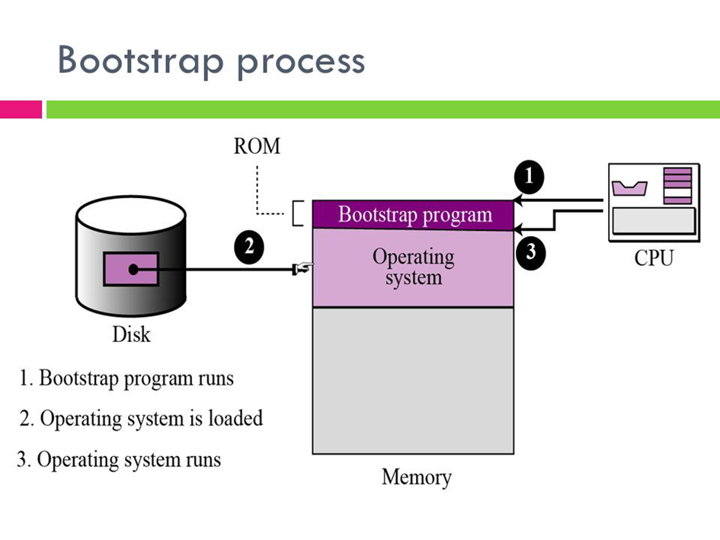
OS Starts
Bootstrap program
Kernel loads
System daemons start
Kernel interrupt driven
Device interrupt
Exception or trap
Division by zero, etc
System call for service
Process handling

Slide 5
Multiprogramming and Multitasking
Many jobs to keep CPU busy (multiprogramming)
Timesharing for multitasking

Slide 6
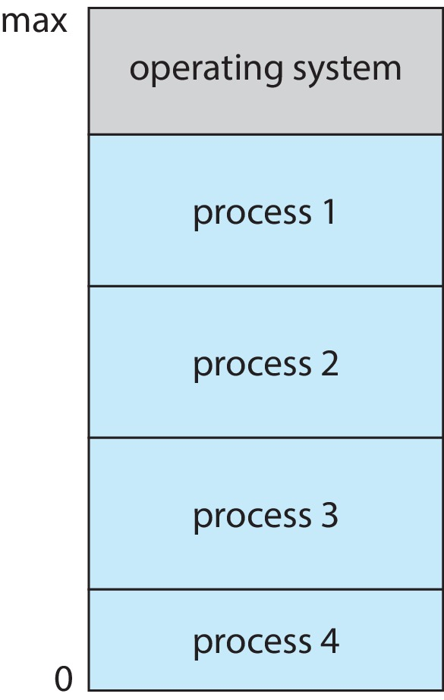
Memory Layout

Slide 7
CPU Modes
Due-mode
User mode vs kernel mode
Mode bit
Privileged instruction only under kernel mode
Multi-mode
Virtual machine manger mode

Slide 8
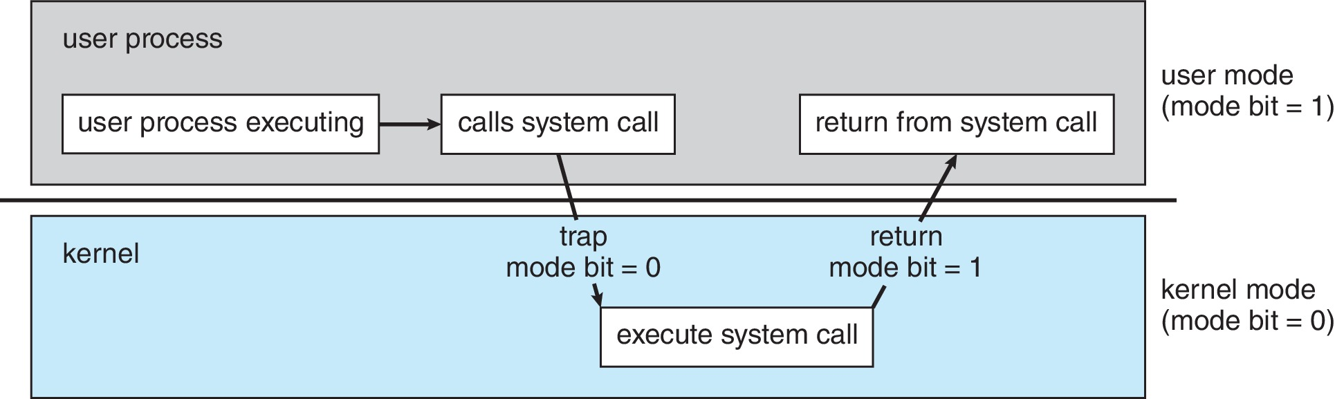
Mode Change and System Call

Slide 9
Timer
Interrupt the computer system after a specific period
Control user programs that
Infinite
Fail to return

Slide 10
Privileged instructions
Machine instructions only run in kernel mode

Slide 11
Which Instructions are Privileged?
Set value of timer
Read the clock
Clean memory
Issues a trap instruction
Turn off interrupts
Modify entries in device-status table
Switch from user to kernel mode
Access I/O device

